Slide 1
SOUND MITIGATION SENSOR
(E/20/019)APPUHAMY H.D.M.D
(E/20/011) AKALANKA N.W.K.D.
(E/20/253) MENDIS A.W.E.R.

Slide 2


Basically… the problem is!

Slide 3
Algorithm
PIR sensor input
The sound detector receives an input exceeding threshold value
Sound Output
NO
YES

Slide 4
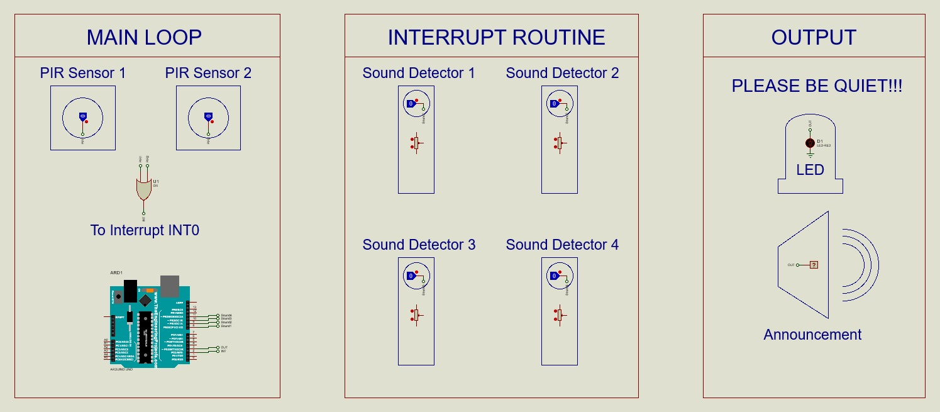
Schematic

Slide 5
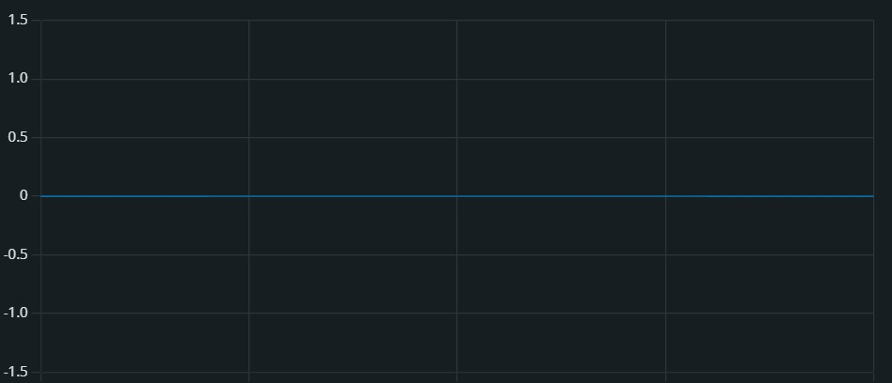
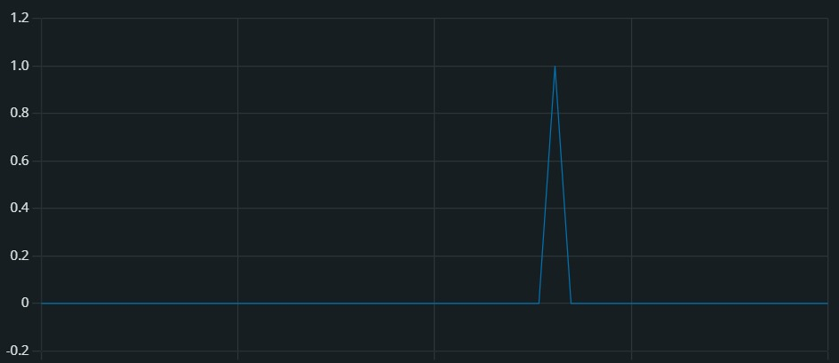
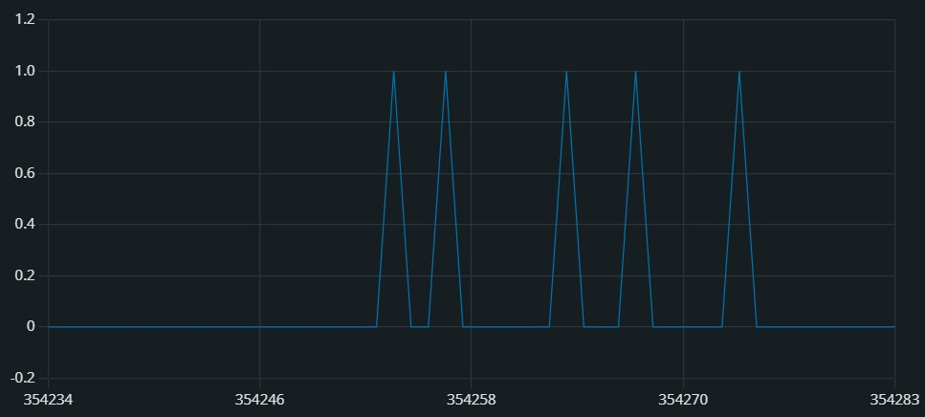
Output from sound detector
No Noise signal
Instantaneous sound disturbance
Prolonged sound interrupt

Slide 6
Simulation Time…

Slide 7
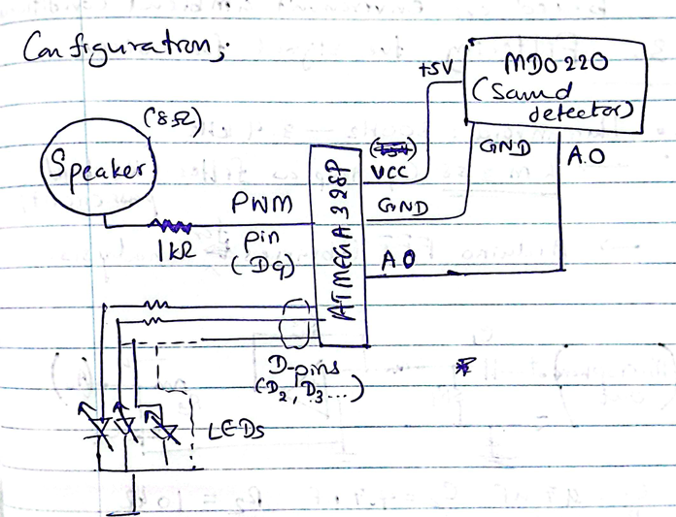
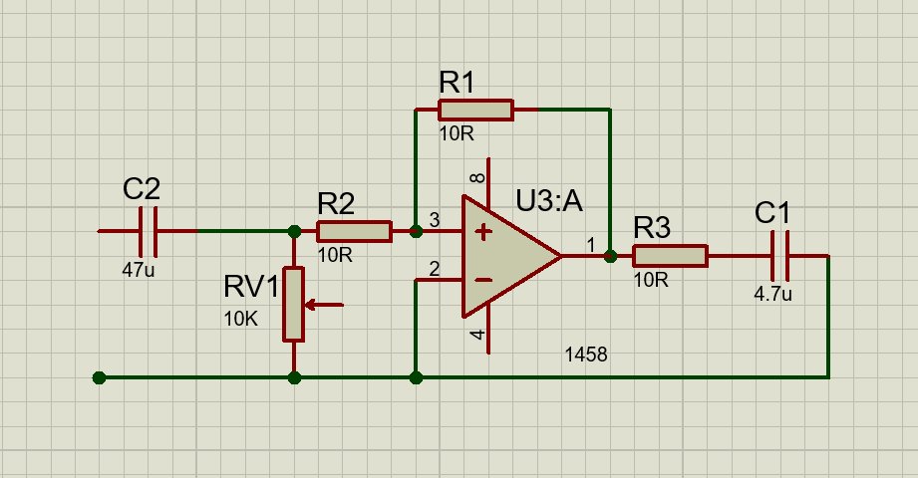
Improvements pending…
Targeted configuration using an ANALOG SIGNAL INPUT
Band-pass filter to filter human voice

Slide 8
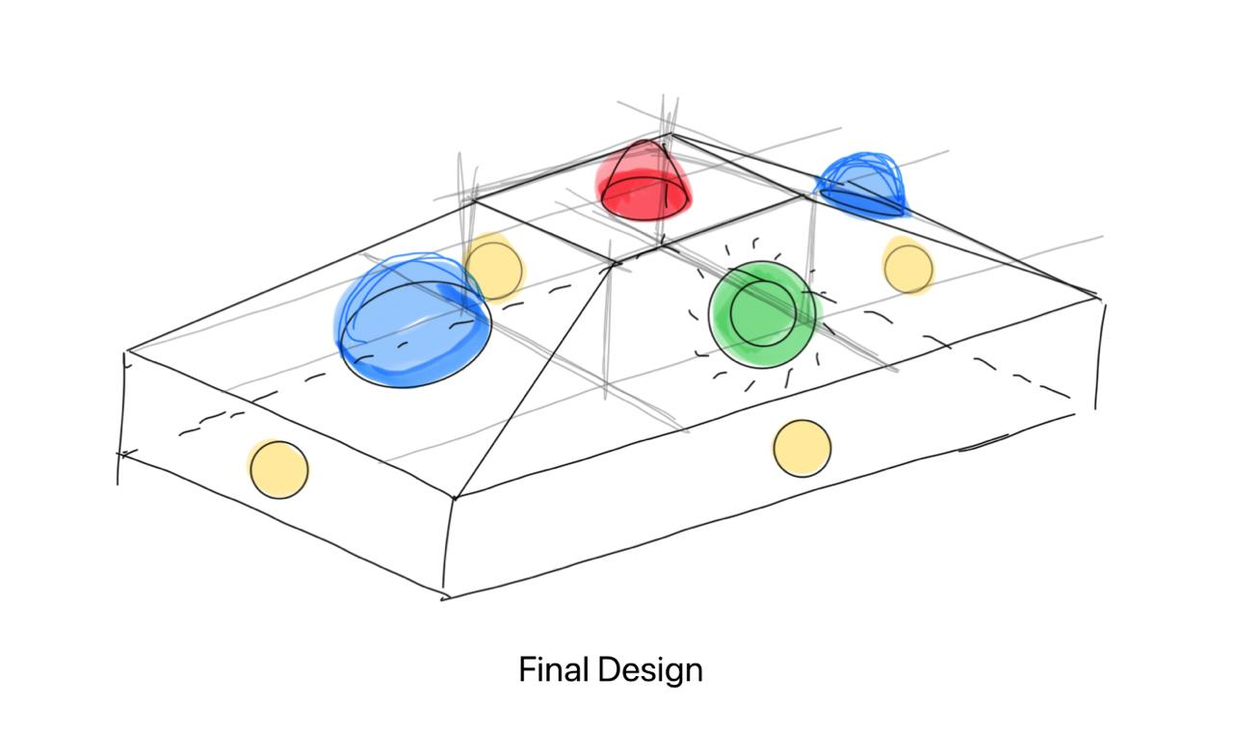

Slide 9
Thank You!
Q&A

